Slide 1
Sequence of Instructions

Slide 2

Program
A program is a sequence of instructions given to a computer.

Slide 3
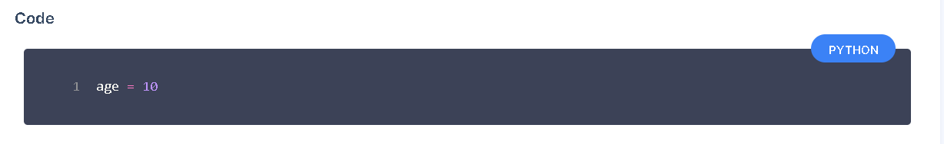
Defining a Variable
A variable gets created when you assign a value to it for the first time.

Slide 4
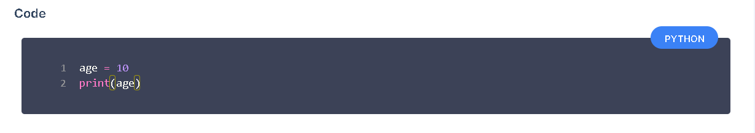
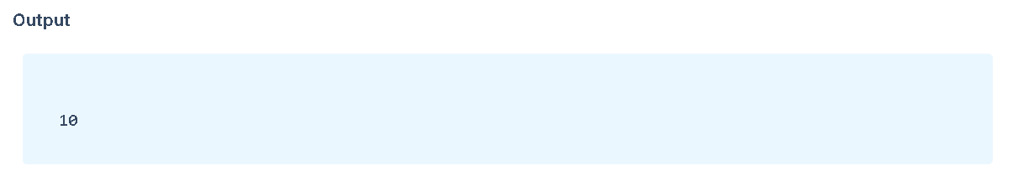
Printing Value in a Variable

Slide 5
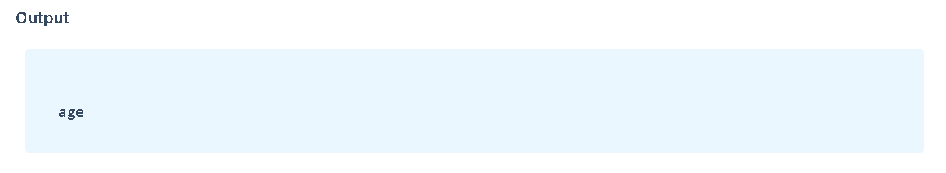
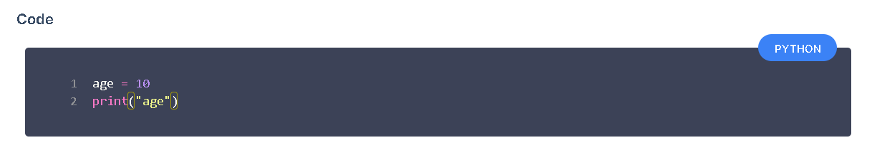
Variable name enclosed in quotes will print variable rather than the value in it. If you intend to print value, do not enclose the variable in quotes.

Slide 6
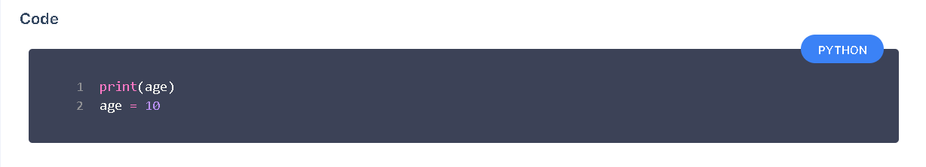
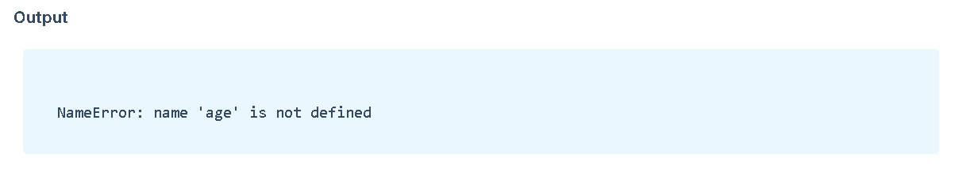
Order of Instructions
Python executes the code line-by-line.
Variable age is not created by the time we tried to print.

Slide 7
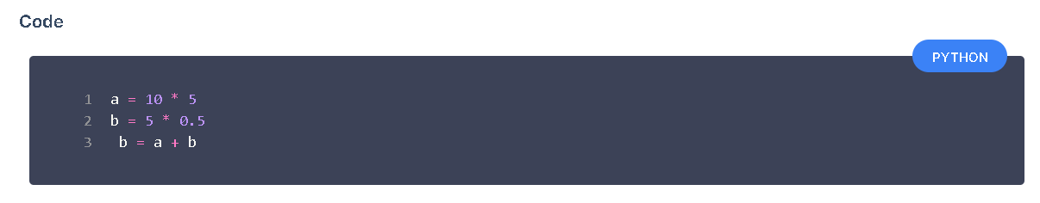
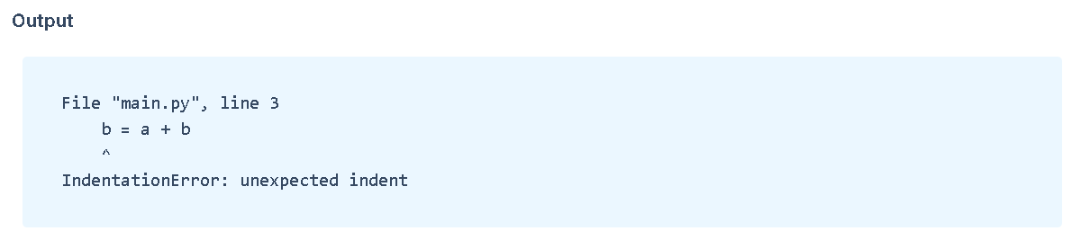
Spacing in Python
Having spaces at the beginning of line causes errors.

Slide 8
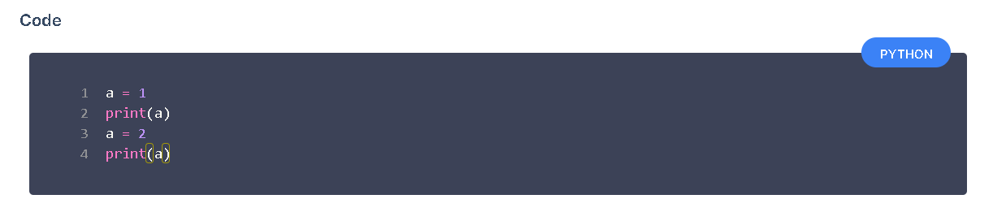
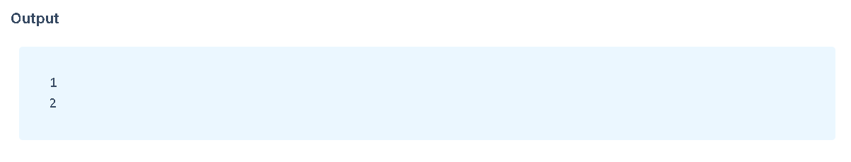
Variable Assignment
Values in the variables can be changed.

Slide 9
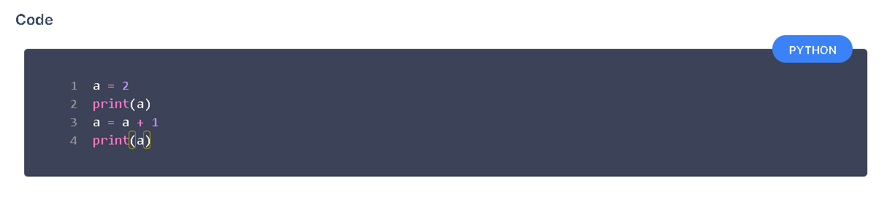
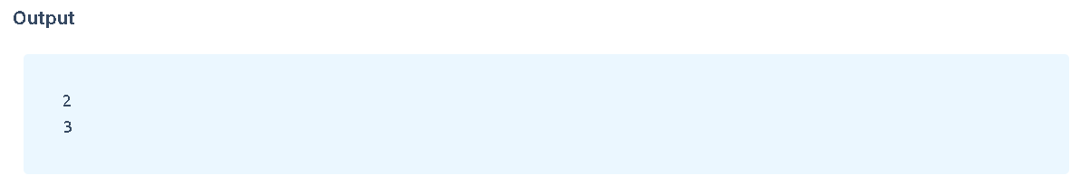
Examples of Variable Assignment

Slide 10
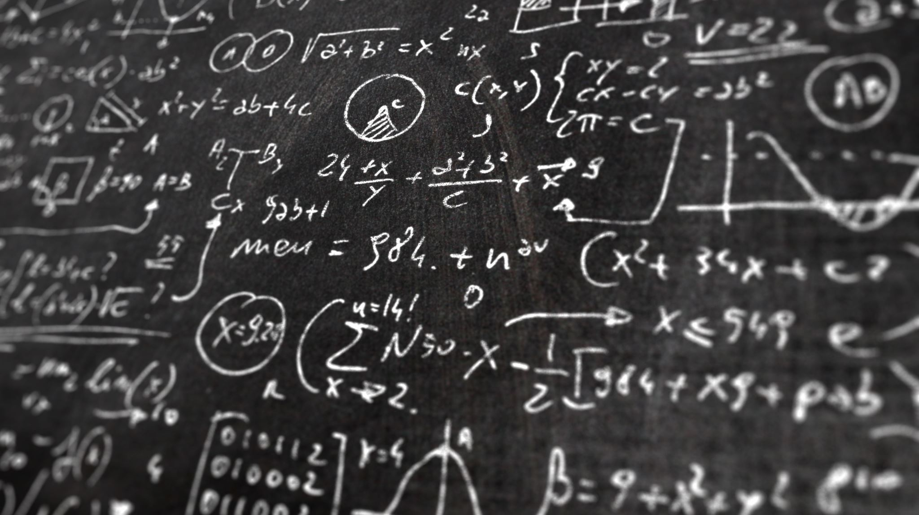
Expression
An expression is a valid combination of values, variables and operators.
Examples
a * b
a + 2
5 * 2 + 3 * 4

Slide 11
BODMAS
The standard order of evaluating an expression
Brackets (B)
Orders (O)
Division (D)
Multiplication (M)
Addition (A)
Subtraction (S)

Slide 12
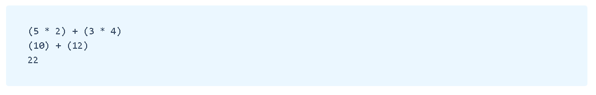
Step by Step Explanation

Slide 13

